Slide 1
Drone Remote ID Protocol
(DRIP)
Tim Mesker
Adam Wiethuechter
InfoNetworks
AX Enterprise
July 2022
IETF 114-Hackathon
Notes:
Good afternoon everyone. My name is Tim Mesker and I am joined here today with my colleague Adam Wiethuechter. We welcome the opportunity to update the IETF community on the work that we were able to accomplish over the past two days.

Slide 2
Safety & Security with Unmanned Aircraft
Need remote identification of unmanned aircraft flying in low altitude airspace
Need to manage sharing of relevant data for shared situational awareness and support for de-confliction
July 2022
IETF 114-Hackathon

Slide 3
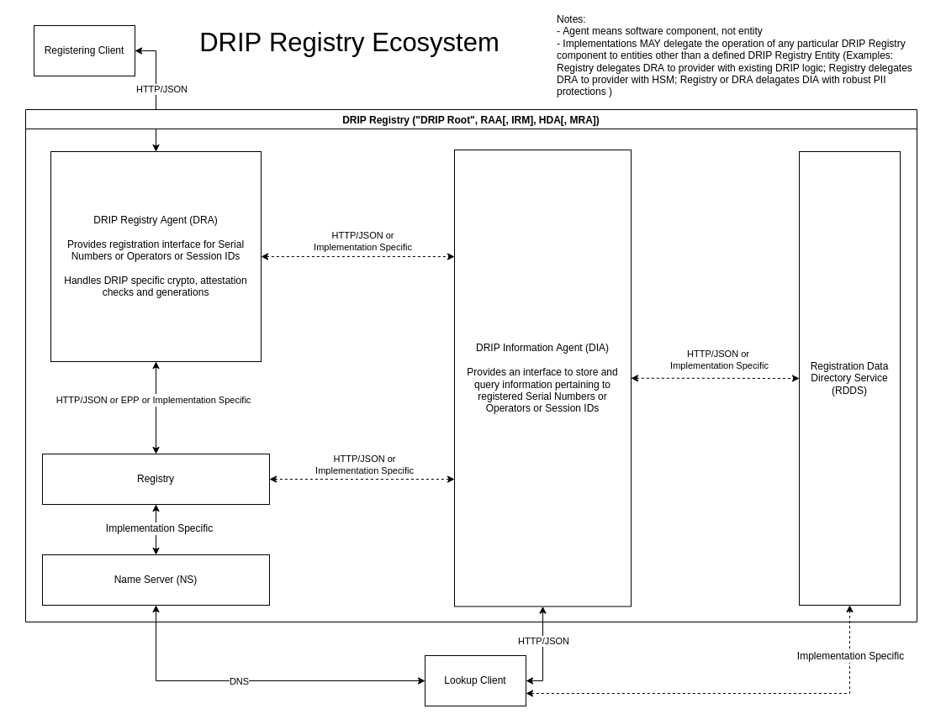
The DRIP Protocol
Addresses registration and remote identification of unmanned aircraft
Drone Remote Identification Protocol (DRIP) Requirements (RFC 9153)
Drone Remote Identification Protocol (DRIP) Architecture
DRIP Entity Tag (DET) Registration & Lookup (DRAFT)
DRIP Entity Tag Authentication Formats & Protocols for Broadcast Remote ID (DRAFT)
July 2022
IETF 114-Hackathon

Slide 4
IETF 114 Hackathon
Challenge: Closed-source broadcaster interoperation with a RDDS provider for differentiated access to UTM data
Accomplished:
Live registration of a DRIP Session ID
Public information look-up using broadcasted Session ID
Authenticated look-up of non-public info using Session id
Refinement of proposed DRIP architecture and RFC’s
July 2022
IETF 114-Hackathon

Slide 5
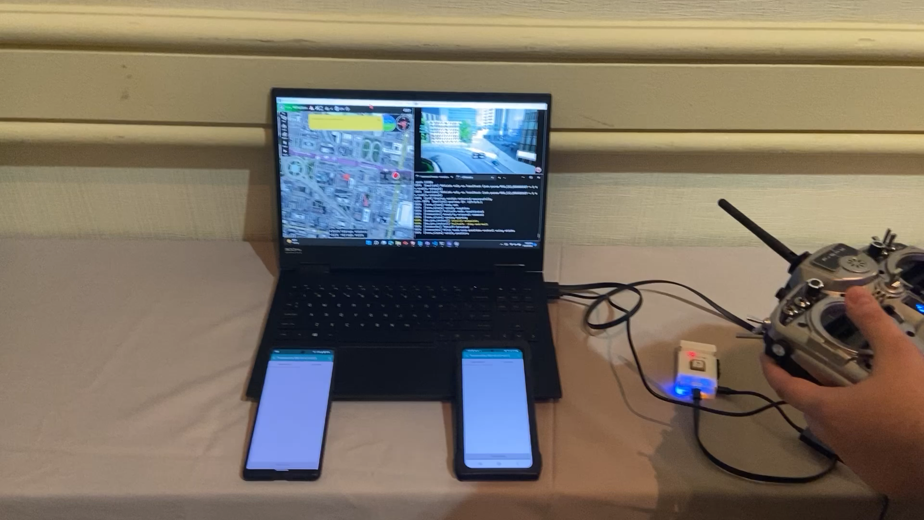
Come see our demo!
July 2022
IETF 114-Hackathon

